Slide 1
Unit 4 - Lesson 5
Conditionals Explore

Slide 3
Unit 4 Lesson 5 - Warm Up
Prompt:
Imagine you want to make a decision about what to wear to an event. Name two pieces of information you'd want. How would you use them in your decision?

Slide 5
Unit 4 Lesson 5 - Activity
Conditionals Explore
You and your partner should have:
Small stacks of red, yellow, and blue stickies
At least three baggies
Pen/Pencil
Dry Erase Marker
MARKER

Slide 6
Unit 4 Lesson 5 - Activity
Information can be stored as...
Numbers
Made of the digits 0...9
No quotes
Yellow sticky
Strings
Made of any characters
Inside double quotes
Red sticky
“hi”
22
9
“hi there”
548
123
“c u l8r”
“123”

Slide 7
Unit 4 Lesson 5 - Activity
Information can be also be stored as a...
Boolean
true or false
blue sticky
false
true
Do This:
Write true on one sticky note and false on another.

Slide 8
Unit 4 Lesson 5 - Activity
3 is less than 8.
<
3
8
evaluates to
true
This is a comparison operator. It’s a clue that we need to STOP and evaluate for a Boolean value.
Comparison operators:
< less than > greater than == equal to | <= less than or equal to >= greater than or equal to != not equal to

Slide 9
Unit 4 Lesson 5 - Activity
3 + 6 < 8
Each side of the comparison operator must be reduced to one sticky note before we can compare
9
< 8
false

Slide 10
Unit 4 Lesson 5 - Activity
Do This:
Evaluate the expressions on each side of the comparison operator.
Then evaluate the expression for a Boolean value.
<
5
6
3
+
-
3
4
1
true
>
2
3
12
/
6
3
-
0
false
(
)
<=
12
3
10
7
-
3
*
false
14
==
14
9
+
5
4
+
10
true

Slide 11
Unit 4 Lesson 5 - Activity
Any of the values in an expression can be a variable.
Do This:
Evaluate the expression for a Boolean value.
lives
score
5
10
9
9
<
lives +
4
score -
5
10
1
false
Note: Any expression that can be evaluate for true or false is known as a Boolean Expression.

Slide 12
Unit 4 Lesson 5 - Activity
Decision time!
Can I go to the movies? I’m allowed to if it’s before 8 o’clock.
Do This:
What information do I need to know?
Create a baggie variable to store that information. Give it a name.

Slide 13
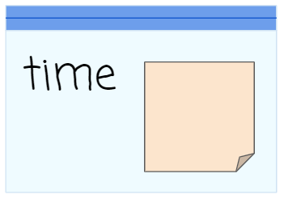
Unit 4 Lesson 5 - Activity
Can I go to the movies? I’m allowed to if it’s before 8 o’clock.
time < 8
true
false
I can go to the movies! 😊
I can’t go to the movies. 😞

Slide 14
Unit 4 Lesson 5 - Activity
Can I go to the movies? I’m allowed to if it’s before 8 o’clock.
It’s 9 o’clock. Can I go to the movies?
9
Assign 9 to the variable time
Comparison operator alert!
Stop and evaluate the Boolean expression.
false
time < 8
9
true
false
I can go to the movies! 😊
I can’t go to the movies. 😞

Slide 15
Unit 4 Lesson 5 - Activity
Have I won the game? I have if my score * my lives is greater than 10.
Do This:
What information do I need to know?
Create baggie variable(s) to store that information. Give them names.
With a partner, discuss what the Boolean expression will look like. What will be compared?

Slide 16
Unit 4 Lesson 5 - Activity
Have I won the game? I have if my score * my lives is greater than 10.
Do This:
With a partner follow the flowchart with these inputs:
Test 1
score = 3
lives = 3
Test 2
score = 1
lives = 10
Test 3
score = -5
lives = 2
score
lives
score * lives > 10
true
false
I won the game!
I haven’t won the game yet.

Slide 17
Unit 4 Lesson 5 - Activity
Challenge!!
Is my dog older than me if his age is converted to human years? Seven dog years equals one human year.
Do This:
What information do I need to know?
Create baggie variable(s) to store that information. Give them names.
With a partner, discuss what the Boolean expression will look like. What will be compared?

Slide 18
Unit 4 Lesson 5 - Activity
Is my dog older than me if his age is converted to human years? Seven dog years equals one human year.
dogAge
myAge
dogAge * 7 > myAge
true
false
My dog is older than me.
I am older than my dog.

Slide 19
Unit 4 Lesson 5 - Activity
What if my decision requires several steps?
Can I adopt a cat?
I can if I have 40 dollars
AND
I am over 14 years old

Slide 20
Unit 4 Lesson 5 - Activity
Can I adopt a cat?
I can if have 40 dollars
AND
I am over 14 years old
Do This:
What information do I need to know?
Create baggie variable(s) to store that information. Give them names.
With a partner, discuss how the flowchart might be set up. What will the Boolean expression(s) look like? What will be compared?

Slide 21
Unit 4 Lesson 5 - Activity
Can I adopt a cat? I can if I have 40 dollars AND I am over 14 years old.
money
39
age
17
Let’s try it out. I am 17 years old and I have $39 dollars.
17
true
age > 14
true
false
false
39
money == 40
false
true
I can adopt a cat! 😊
I can’t adopt a cat. 😞

Slide 22
Unit 4 Lesson 5 - Activity
Boolean values are a type of information, so they can also be evaluated in a Boolean expression using logical operators.
false
Logical Operators:
&& AND
|| OR
! NOT
true
&&
false
If something is true and (&&) false, it evaluates to false.

Slide 23
Unit 4 Lesson 5 - Activity
Let’s take a look at Truth Tables
In the next few slides, we are going to change the color of the sticky notes a little bit. Boolean values will still be on blue stickies, but true will be a dark blue, and false a light blue.
true
false

Slide 24
Unit 4 Lesson 5 - Activity
Truth Tables - used in evaluating Boolean expressions
&& AND
&&
Both must be true for the Boolean expression to evaluate as true.
true
&&
true
true
true
true and true evaluate to:
true
&&
false
false
true and false evaluate to:
false
false
&&
true
false
false and true evaluate to:
false
false
&&
false
false
false and false evaluate to:
false

Slide 25
Unit 4 Lesson 5 - Activity
Do This:
With a partner, predict the results for each line in the || OR table
||
Either may be true for the Boolean expression to evaluate as true.
|| OR
true
||
true
true
true or true evaluates to:
true
true
||
false
true or false evaluates to:
true
true
false
||
true
true
false or true evaluates to:
true
false
||
false
false
false or false evaluates to:
false

Slide 26
Unit 4 Lesson 5 - Activity
The ! NOT table is easy! The results are the opposite of the Boolean value.
! NOT
!
true
false
not true evaluates to:
false
!
false
true
not false evaluates to:
true

Slide 27
Unit 4 Lesson 5 - Activity
Use logical operators to combine several Boolean expressions into one expression.
Can I adopt a cat?
I can if I have 40 dollars
AND
I am over 14 years old

Slide 28
Unit 4 Lesson 5 - Activity
Can I adopt a cat? I can if I have 40 dollars AND I am over 14 years old.
money
40
age
15
Let’s try it out. I am 15 years old and I have $40 dollars.
Truth Table
true
true
&&
true
true
true
true
&&
money == 40 && age > 14
40
15
true
false
I can adopt a cat! 😊
I can’t adopt a cat. 😞

Slide 29
Unit 4 Lesson 5 - Activity
Do This:
Now it’s your turn to make a flowchart. On a scrap sheet of paper:
Think back to the warm-up where we discussed making a decision on what to wear to an event.
Write down the variables in boxes at the top.
Inside the diamond shape, create the Boolean expression that will be used to make the decision.
Draw True/False lines to the possible decisions.
Challenge: Use logical operators (&&, ||, or !) in your Boolean expression. Add extra branches with multiple decisions.
Test your flowchart with a friend!
Decision:

Slide 30
Unit 4 Lesson 5 - Activity
Key Takeaways
A Boolean Value is a data type that is either true or false.
Comparison Operators <, >, <=, >=, ==, != indicate a Boolean expression
Each side of the Boolean expression is reduced to a single value
Single values are compared and result in a Boolean value (true or false)
10
<
2
false
evaluates to
4
==
4
true
evaluates to

Slide 31
Unit 4 Lesson 5 - Activity
Key Takeaways
Boolean expressions can also include Logical Operators &&, ||, != (AND, OR, NOT). Both sides of the logical operator are reduced to a single Boolean value
A truth table is used to evaluate the reduced Boolean expression to a single Boolean value
A decision is made with the single Boolean value
A flowchart illustrates the steps of making a decision with a Boolean expression
true
&&
false
evaluates to
false
true
||
false
evaluates to
true

Slide 33
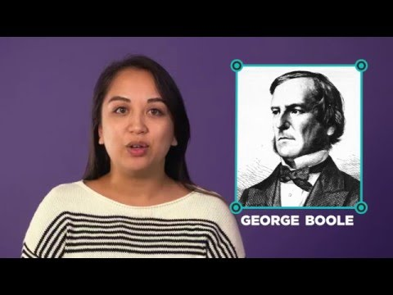
Unit 4 Lesson 5 - Wrap Up

Slide 34
Unit 4 Lesson 5 - Wrap Up
Boolean Value: true or false
Boolean Expression: evaluates to either true or false
true
false
3
<
8
evaluates to
true

Slide 35
Unit 4 - Lesson 6
Conditionals Investigate

Slide 37
Unit 4 Lesson 6 - Warm Up
Prompt:
A water park will let a visitor on a ride if they are 48 or more inches tall OR they are 14 years old or older.
Make a flowchart for this decision. Make sure to use comparison operators (<, >, ==, etc. ) and logical operators (&&, ||, !) when you write your Boolean expression.

Slide 38
Unit 4 Lesson 6 - Warm Up
"when": Means there is an onEvent to respond to user input. The app does something "when" the user clicks.
"if": Means there is a conditional statement that decides what pieces of code to run. The app does something "if" a boolean expression evaluates to true.

Slide 40
Unit 4 Lesson 6 - Activity

Slide 41
Unit 4 Lesson 6 - Activity
Lemon Squeeze Pt 1
Do This
Play the game at least once. Then with a partner, choose one of the three code sections below
Section 1: lines 1 - 13
Section 2: lines 16 - 30
Section 3: lines 33 - 53
Read the code in your section carefully, making sure you understand how each line works.
Discuss
Find partners from the two other groups and:
Explain what your section does
Call out any lines of code you thought were interesting or confusing
Ask good questions about how their section works, for example: "I don't understand this line" or "What does this command do?" or "Could your section have been written another way?"
Modify
Right now the game keeps going when the player has 0 lives. Fix this problem.

Slide 42
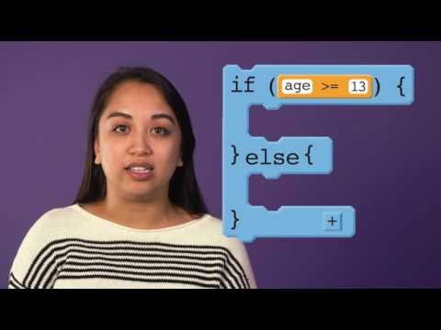
Unit 4 Lesson 6 - Activity

Slide 43
Unit 4 Lesson 6 - Activity
Do This:
Look at lines 53-59. Discuss with a partner how the MOD operator % works.

Slide 44
Unit 4 Lesson 6 - Activity
MOD
Add | 3 + 2
Subtract | 3 - 2
Multiply | 3 * 2
Divide | 3 / 2
MOD | 3 % 2
5
1
6
1.5
1
MOD is the remainder that is left after a number is divided by another number

Slide 45
Unit 4 Lesson 6 - Activity
Let's Practice
the answer
17 % 5
3
remainder 2
5 17
-15
2

Slide 46
Unit 4 Lesson 6 - Activity
When is this useful?
A common usage is to determine if a number is even or odd. If you divide any number by two and there is no remainder, the number is even!
You can use MOD to determine if a number is divisible by another number.

Slide 47
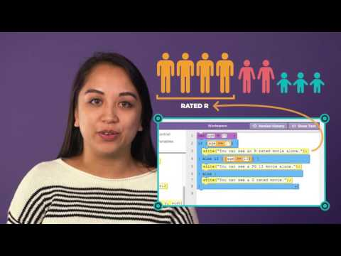
Unit 4 Lesson 6 - Activity

Slide 48
Unit 4 Lesson 6 - Activity
Lemon Squeeze Pt 2
Do This
Play the game at least once.
Discuss with a partner what's changed since last time in how the game works.
Find the if-else-if statement that was added to the program.
Draw a flowchart for the if-else-if statement
Modify the program so that the lemon becomes even smaller when the user has more than 15 points.

Slide 49
Unit 4 Lesson 6 - Activity

Slide 50
Unit 4 Lesson 6 - Activity
Lemon Squeeze Pt 3
Do This
Play the game at least once.
Discuss with a partner what's changed since last time in how the game works.
Find the if-else-if statement that was added
Draw a flowchart for the if-else-if statement that was added
Modify the app to add one more username and password. You'll need to edit both the code and user interface. Warning: Use a fake password. It's never a good idea to use real passwords directly in your code like this.

Slide 52
Unit 4 Lesson 6 - Wrap Up
Prompt:
What is the difference between an if-statement, an if-else statement, and an if-else-if statement? How are they similar?

Slide 53
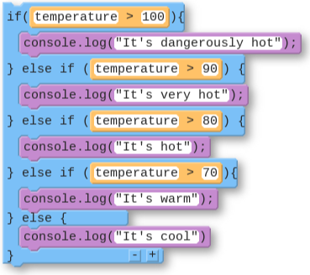
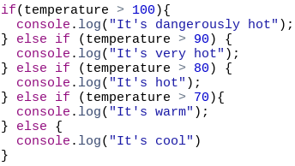
Unit 4 Lesson 6 - Wrap Up
Checking Multiple Conditions with If-Else-If
Name | Code (Block) | Code (Text)
Checking Multiple Conditions with If-Else-If

Slide 54
Unit 4 - Lesson 7
Conditionals Practice

Slide 57
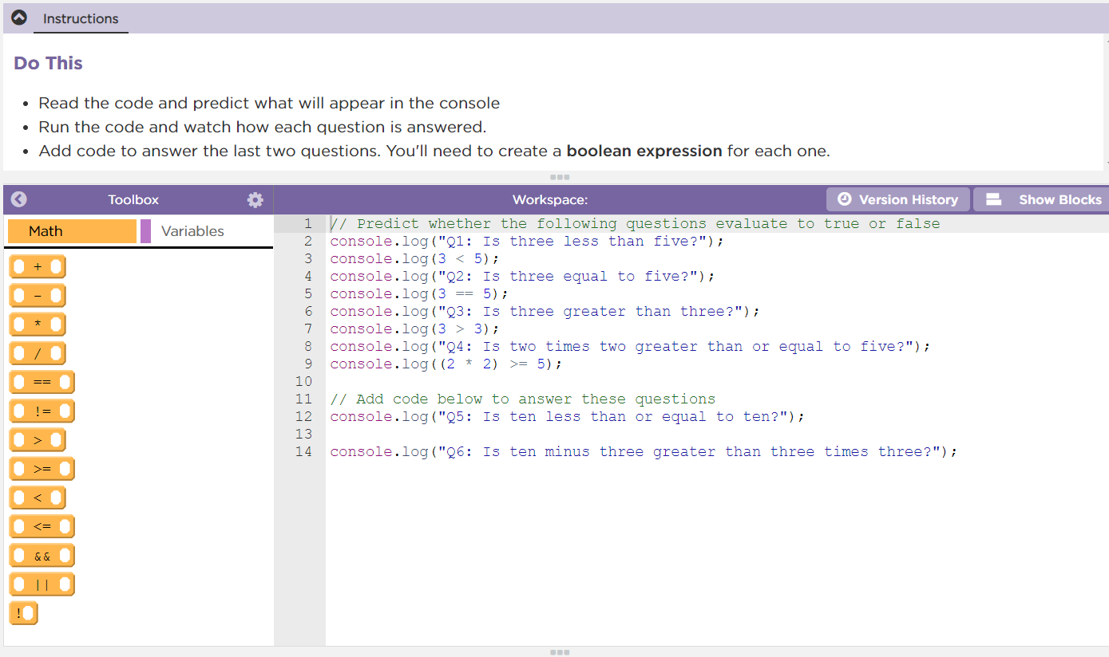
Unit 4 Lesson 7 - Activity
Conditionals Practice:
Do This:
Navigate to Lesson 7, Level 1 on Code Studio

Slide 58
Unit 4 Lesson 7 - Activity
Debugging: the process of finding and fixing problems in code
Describe The Problem What do you expect it to do? What does it actually do? Does it always happen? | Hunt For Bugs Are there warnings or errors? What did you change most recently? Explain your code to someone else Look for code related to the problem
Try Solutions Make a small change | Document As You Go What have you learned? What strategies did you use? What questions do you have?

Slide 59
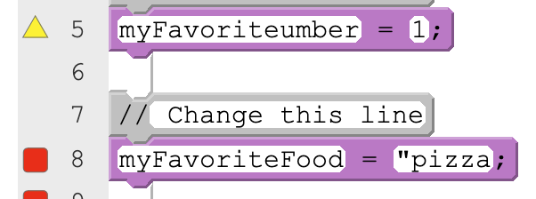
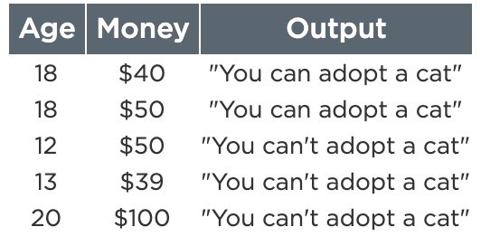
Unit 4 Lesson 7 - Activity
Specific Debugging Skill for the Day
Error Type | Example | How to Debug
Syntax Error: Your code doesn’t follow the rules of the programming language | Writing a variable name in quotes Using a variable that doesn’t exist | Check warnings and errors
Logic Error: Your code follows the rules of the programming language but doesn’t do what you intend | Writing if-else-if statements in the wrong order Updating the property of the wrong element | Test your code
Practice checking for both syntax errors and logic errors in your programs.

Slide 61
Unit 4 Lesson 7 - Wrap Up
Prompt:
What aspects of working with conditionals do you feel like clicked today?
What do you still feel like you have trouble with?

Slide 62
Unit 4 - Lesson 8
Conditionals Make

Slide 65
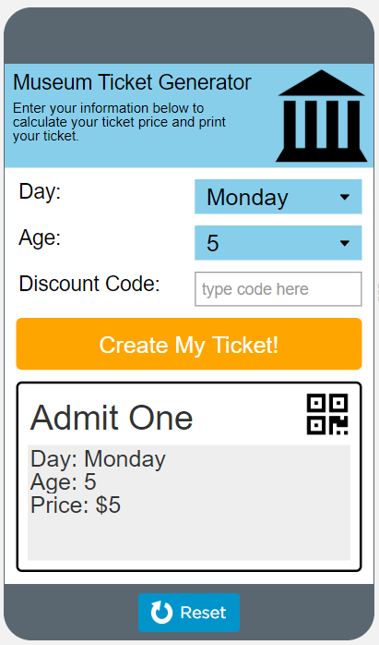
Unit 4 Lesson 8 - Activity
Conditionals Make:
Museum Ticket Generator
Do This:
Navigate to Lesson 8, Level 1 on Code Studio

Slide 66
Unit 4 Lesson 8 - Activity
Step 1 - Try the app
Try making tickets for different combinations of inputs.
Make a ticket for a weekend.
Make a ticket for a weekday (Monday - Friday) and someone 18 or younger.
Try the discount code "FREEFRIDAY" on a Friday.
Discuss with a Partner
What variables would you need to program this app?
Where does this app use conditionals (if-statements)?

Slide 67
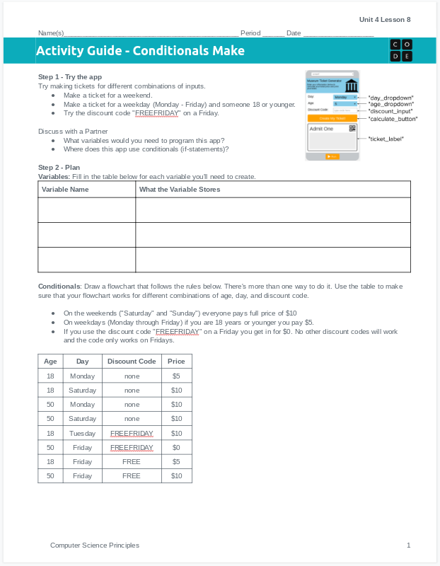
Unit 4 Lesson 11 - Activity
Do This: Make the Museum Ticket Generator!
Use the activity guide to plan out your code, including the variables you'll create and a flowchart of the conditional statement you'll need to write.
Step 3 includes steps you can follow to build the app, or you can use your own process.

Slide 68
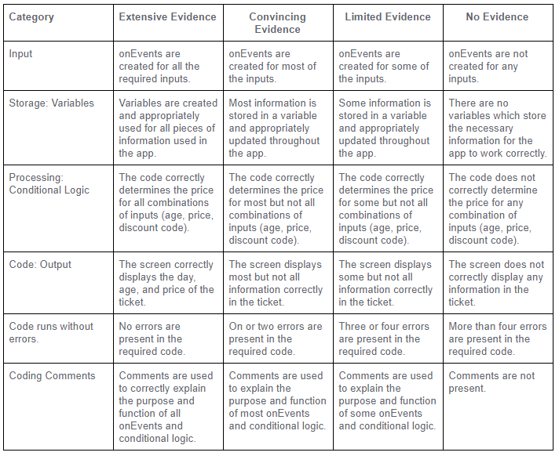
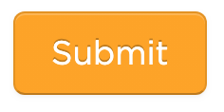
Unit 4 Lesson 8 - Activity
Don't forget to check the rubric before hitting submit!

Slide 70
Unit 4 Lesson 8 - Wrap Up
Great job today!

